Slide 1
Expected TPC performance in 2018 pb-pb collisions at high rates
Kai Schweda, GSI Darmstadt, for the ALICE TPC group

Slide 2
Executive Summary
Readout rate (central triggers)
optimum of 375 s⁻¹ at 6 kHz, 355 s⁻¹ at 10.9 kHz interaction rate
Distortions in IROCs (cover electrode potential +180V)
Δrφ < 1.0 cm (1.4 cm) at 8 kHz (10.9 kHz) Pb-Pb interaction rate
Distortions in OROC C06 (two floating gating grid wires, ΔHV = -50 V)
Δrφ < 4 cm (8 cm) at 8 kHz (10.9 kHz) Pb-Pb interaction rate
Particle identification
PID separation power decreases by 10% from 6 kHz to 8 kHz IR

Slide 3
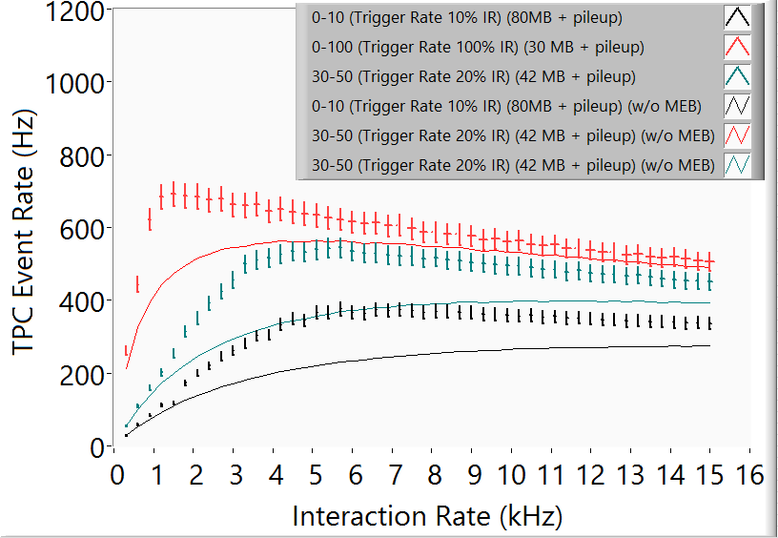
Readout rate
Multi event buffering (4x)
Maximum readout rate of 375 s⁻¹ at 6 kHz
Decreases linearly
to 355 s⁻¹ at 10.9 kHz
Double rate compared to former RCU

Slide 4
Distortions in inner rocs
Δrφ < 1.0 cm at 8 kHz
can be well calibrated
back to design performance
Δrφ < 1.4 cm at 10.9 kHz
can be calibrated
fluctuations might play a (small) role
→ time-dependent QA
to filter out events with large fluctuations

Slide 5
Distortions in outer roc c06
OROC C06 has two floating gating grid wires
anode voltage reduced ΔHV = -50 V
Δrφ = 4 cm at 8 kHz
can be calibrated
Δrφ = 8 cm at 10.9 kHz
→ cluster loss
fluctuations play a role
Also: OROC A05
at ΔHV = -60 V for operational stability

Slide 6
Particle identification
π / e (LHC15o, Pb-Pb)
dE/dx separation power decreases linearly with interaction rate (occupancy)
number of wrongly assigned clusters increases
Decrease is 10%
from 6 kHz to 8 kHz

