Slide 1
Polywater - case study of an anomaly -
by
Maximilian Hartmann
Seminar: „Die größten Irrtümer in der Physik“
Supervision: Markus Köhli

Slide 2
Icarus 12

Slide 3
Outline
Anomalous water
Polywater
Historic development
Communication in Science
Epistemology

Slide 4
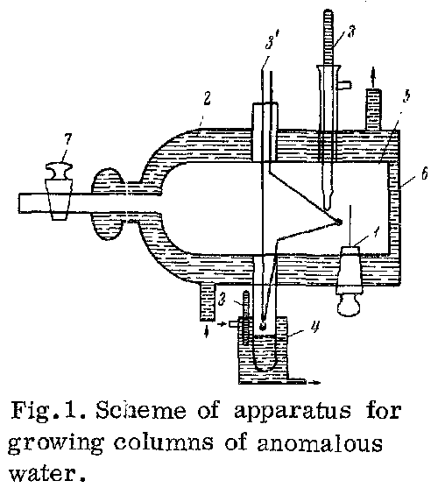
Anomalous water
Review: Vapor pressure
Fedyakin, 1962
Notes:
Physics of liquids and solids. Saturation pressure. Background: influence of solid surfaces on thin layers of liquids
Apparatus $⇒$secondary columns (1.5 mm one month after sealing)

Slide 5
Anomalous water
Anormal properties
Vapour pressure
Viscosity
Density
Surface tension
Refractive index
Electric conductivity
Thermal expansion
....
Fedyakin, 1962
„Change in the Structure of Water
during Condensation in Capillaries“
Kolloid Zhurnal
B.V. Derjaguin
Department of Surface Phenomena
Institute of Phys. Chemistry Karpov
Publisher „Kolloid Zhurnal“
Notes:
Properties: freezing and boiling point
Interpretation: water with new structure through contact $⇒$ stable
Derjaguin: internationally renowned scientist
Nature of forces between solids
Properties of thin liquid layers
High standard experimentalist
Better production of anomalous water:
Faster -> no leaching
Quartz capillaties -> pure substance
Start without water in capillaries $⇒$ no contamination
Optimize
Pressure
Diameter
Temperatures $⇒$ no contamination
Discrepancies between measurements: mixtures of water and anomalous water!!!
All measurements on microgramms
Derjaguin‘s interpretation

Slide 6
History
Discovery
Gordon conference
$1^{st}$repetition
1^𝑠𝑡 repetition
„Polywater“
Moscow conference
Nottingham conference
Revocation
1962
1966
1969
1973
campaign
Phases:
phenomenological
spreading
controverse

Slide 7
Methods of investigation
West
Theory
Spectroscopy
East
Classical methods
Experimenting ON
Vibrational spectra (Raman, IR)
NMR
Mass spectrometer
Chemical analysis
!?
contamination

Slide 8
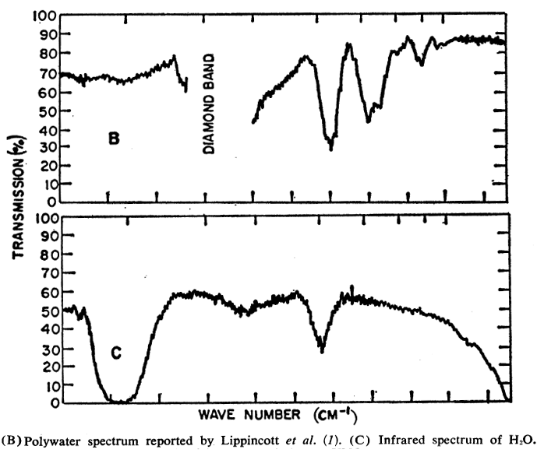
Spot on 1969
Discovery
„Polywater“
Nottingham conference
Revocation
1962
1966
1969
1973
„Polywater“
Coverage
Popular science
Daily press
Lippincott, Stromberg
IR spectrum
$⇒$ comparison to 100000
other spectra
Theories pop up
1969
Critics gather
Symposia,
Congresses
A.G. Leiga et al., Science 168
Notes:
Title Picture

Slide 9
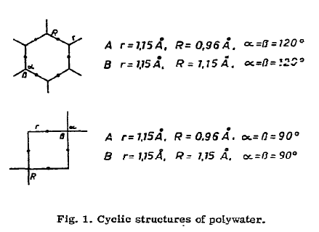
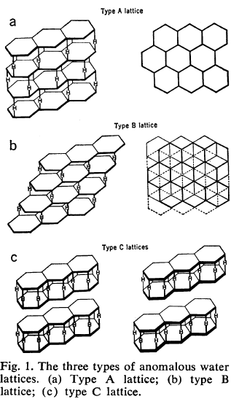
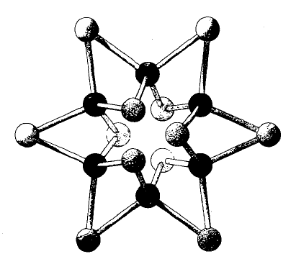
Theoretical polymer structures
Discovery
„Polywater“
Nottingham conference
Revocation
1962
1966
1969
1973
Azman, Chem.Phys.Lett. 5
Ageno, Theoret. chim. Acta 17
Allen, Kollman Science 167
Notes:
Pop-up mushrooms
How experienced can that have been?

Slide 10
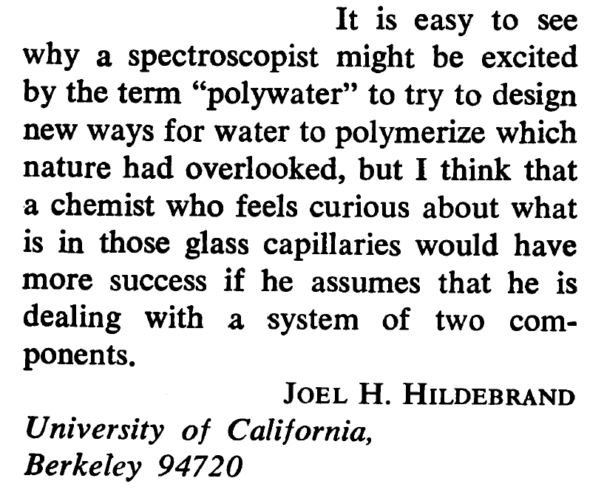
Critics
Discovery
„Polywater“
Nottingham conference
Revocation
1962
1966
1969
1973
Polymer VS impurities
Two approaches
Find another substance that fits spectra
Find impurities in samples (organic/mineral)
Stability arguments
$⇒$„Polywater hard to swallow“
Science Vol. 168
Notes:
Perception...
Extreme stands: „A totally biased effort to demonstrate the presence of silicia... I was a seeker of truth, as I saw it...“
Mob of scientists unsure to take a stand
Nothing to loose and a lot to gain??
Financial aspect, citations = money, dead-end field = less citations

Slide 11
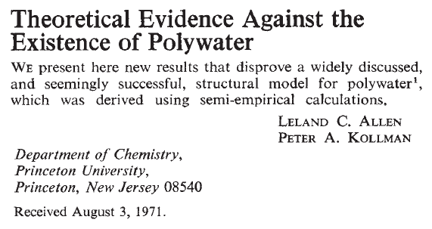
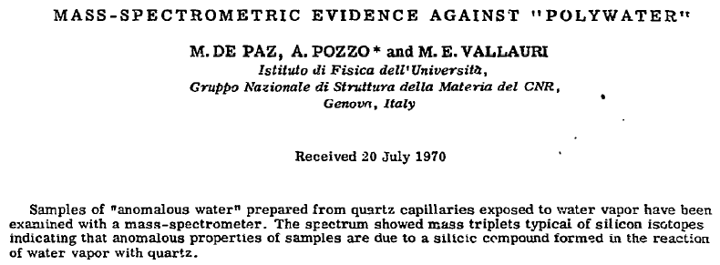
Discovery
„Polywater“
Nottingham conference
Revocation
1962
1966
1969
1973
Nature Vol. 233
Rousseau
Science Vol. 171
Chem.Phys.Lett. Vol. 7
Notes:
Theoreticians: calculations simplyfied for technical and financial reasons
How did it come to this???
Quellen

Slide 12
Discovery
„Polywater“
Nottingham conference
Revocation
1962
1966
1969
1973
Nature Vol. 244
Notes:
There is no doubt that something exists.
But what is it in particular?

Slide 13
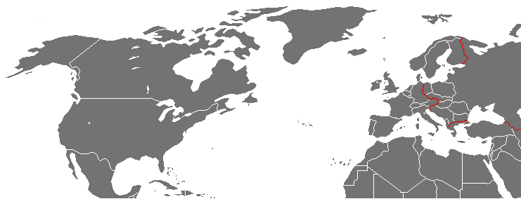
Network
Deryagin is the authority
Strange argumentation
How are scientific facts created?
Notes:
How are scientific facts created?
Network resources
Social construction
Cold war:
iron curtain -> politics mess into science
No exchange of samples -> Derjaguins water
Human factor: weighting evidence
Authority arguments

Slide 14
Network
Broad interest
Biology, botanics
Medial coverage
Popular scientific papers
Good funding
Soviet Academy of Science
Astrophysics, geology
Industry
US Dep. Of Defense
Unilever
Daily press
Wallstreet journal
Short circuit
Notes:
Nothing to loose, but a lot to gain
Funding bias
Loads of anomalies… what is interesting is the attention it got.
how polywater might be used as...
weapon
building material
that polywater might …
be responsible for the absence of water on venus
endanger life on earth

Slide 15
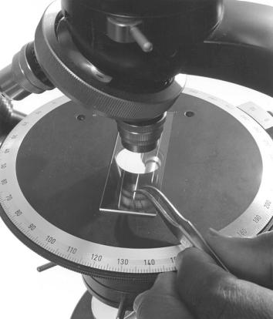
Discussion
Rules to science
During its time (1962-73),
did polywater exist?

Slide 16
Literature
Polywater, sociology of an artifact, G. Benguigui, Social Science Information (1993)
Polywater and Experimental Realism, J. Van Brakel, Brit. J. Phil. Sci. 44 (1993)
Experimenting on and Experimenting with: Polywater and Experimental Realism, W.J. McKinney, Brit. J. Phil. Sci. 42 (1991)
Nature of Anomalous Water, B.V. Derjaguin and N.V. Churaev, Nature Vol. 244
"Polywater" Is Hard To Swallow, J.H. Hildebrand, Science Vol. 168
Polywater, E.R. Lippincott et al., ScienceVol. 164
Theoretical Evidence Against the Existence of Polywater, L.C. Allen and P.A. Kollman, Nature Vol. 233
Mass-Spectrometric Evidence Against „Polywater“, M. De Pay et al., Chem.Phys.Lett. Vol. 7
"Polywater" and Sweat: Similarities between the Infrared Spectra, D.L. Rousseau, Science Vol. 171
Is Venus a Polywater Planet?, F.J. Donahoe, Icarus 12 (1970)
The Career Consequences of a Mistaken Research Project, A.M. Diamond Jr., American Journal of Economics and Sociology (2009)

